Slide 1
A Sketch-Based Interface for PowerPoint
Purpose:
The interfaces of most programs are designed for use with a mouse and keyboard, rather than a stylus drawing directly on the screen; using a stylus with these interfaces is often awkward or clumsy. We aim to solicit user feedback on various stylus interface designs. We will use this feedback to develop an intuitive and convenient pen-based interface for PowerPoint on Tablet PC. Ultimately, we hope to contribute data to the field of user interaction design.
Ellen Kephart & Alice Zhu
Advisors: Christine Alvarado & Sarah Harris
User Feedback:
The following are some important user interface issues that we explored and addressed in our interface.
Limited gesture set:
It’s difficult for users to remember so many different gestures and which actions they trigger. We tried to pair up actions with intuitive gestures when possible, but most of the time no particular gesture is intuitive for an action.
Gesture trigger vs. button trigger:
Is it easier for the user to trigger actions, such as text recognition, with a gesture or a button? For most users, gesture is easy but not reliable while button is consistent but cluttering. For common actions, a gesture is preferable, for it’s less distracting and can improve over time.
Intuition:
People have already been trained on certain tasks by existing programs, and new interfaces should build upon their intuition, eliminating the need to retrain.
Feedback:
When and how the user receives feedback is important for our design. We want to find the ideal amount and type of feedback for various actions. For example, we currently have visual, text, and pop up feedback for adding objects, manipulating text, and delete all objects, respectively.
Methodology:
After brainstorming and doing initial research, we implemented a basic interface with which the user can gesture, sketch, and write. We then conducted user studies, gaining feedback on our design and investigating the types of interface users prefer for tasks such as adding text or manipulating shapes. From this feedback, we improved our design to better meet users’ expectations, and attempted to draw conclusions about the principles behind their preferences. Next, we perform additional user studies and continue to improve our interface.

Slide 2
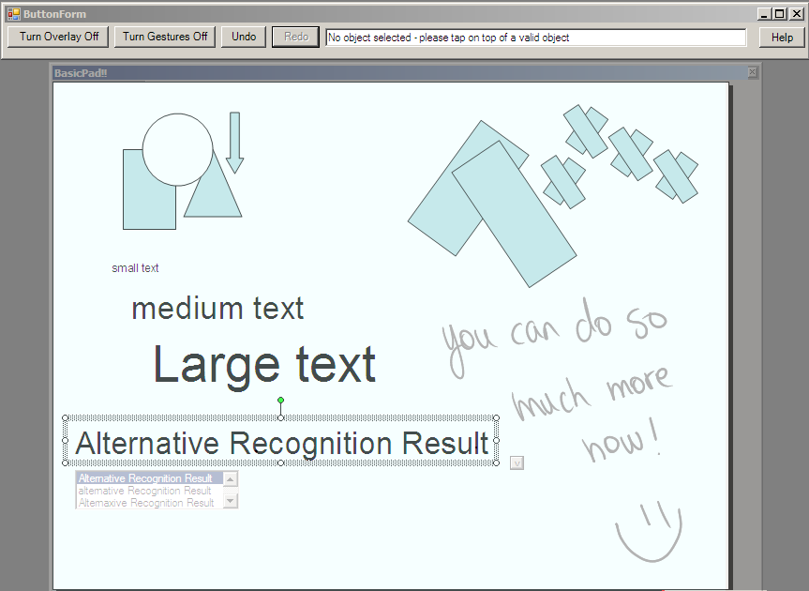
Technical Details:
We used the Microsoft Tablet PC SDK and Office COM Add-Ins feature to create a PowerPoint add-in in C#. This add-in consists of a transparent pop-up window which overlays the slide and a solid form containing various command buttons. The user gestures or writes upon this overlay to create and edit PowerPoint presentations.
Interface Features:
Use gestures for common, often repeated tasks including cut, copy, paste, delete, and navigation between slides
Simply sketch out common shapes such as square, circle, and arrow to easily add those to the slide
Move, rotate, and resize the shapes in the same way PowerPoint does, appealing to user intuition and eliminating need to retrain
Undo Button (instead of using a gesture) to ensure users can reliably undo, and reduce the possibility of accidental triggering
Write with the stylus, and gesture for the handwriting to be converted to text in the same location and of the same size it was written in
Alternative recognition results available for each recognized text in drop down menus.
Simple gestures to edit text to correct for minor recognition mistakes
Help menu with a list of all gestures
Textual feedback for each user action
And more!
undo
feedback
help
sketch
rotate &
resize
write
& edit
Future Work:
Conduct additional user studies to improve our interface and gather more data about user preferences
Work to remove existing bugs
recognize
Funded by the R.C. Baker Foundation and the Beckman Foundation

